Slide 1

Diabetes Prediction Using Machine Learning
Rakibul Hasan Rona (ID: 16155026)
Tarjuman Akter Liza (ID: 16155017)
University of Information Technology & Sciences
Presented To:
Mr. Md. Mynoddin
Lecturer,UITS

Slide 2
Outline:
Overview of Diabetes
Why Machine Learning is Needed in Diabetes
Prediction?
Dataset
Sample Of Our Dataset
Equipment & Environment setup
Analysis of Dataset
K-Nearest Neighbors (KNN) Algorithm
Methodology
Visualization of training and test data accuracy Of K-NN
Take user input
Output and Prediction
Training and test data accuracy Of DECISION TREE

Slide 3
Overview of Diabetes:
Diabetes is a very common disease in all over the world of all age groups.
425 million people have diabetes globally and 200 million of them do not even know they have the disease
Diabetes is a group of metabolic disease in which the body is unable to properly use and store glucose.
The diagnose of diabetes depends on the condition of Glucose, Blood Pressure, Skin Thickness, Insulin, BMI, Age etc.

Slide 4
Why Machine Learning is Needed in Diabetes
Prediction?:
To diagnose diabetes, a physician has to analyze many factors, data to take a expert decisions that are very critical.
It is very easy to predict diabetes.
Fast diagnose diabetes.
help to analysis those reports
Make awareness of diabetes.

Slide 5
Dataset:
A dataset is use to analysis and training that used to make a prediction.
The dataset will be in csv form.
The dataset we have used here is originally from the ‘National Institute of Diabetes and Digestive and Kidney Diseases’.
All patients here are females here
This diabetes dataset consists of 768 data points, with 9 features each

Slide 6
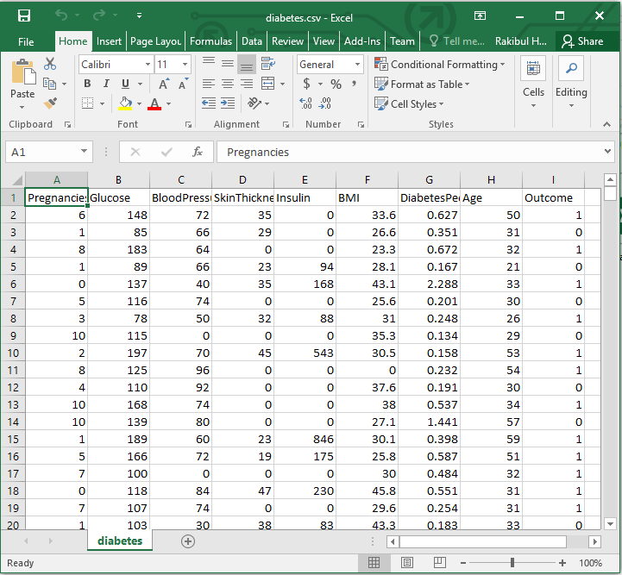
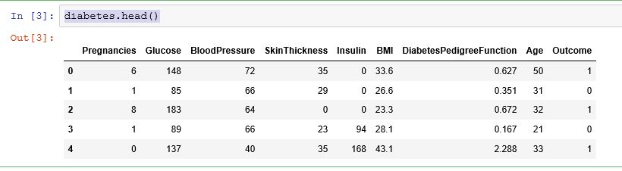
Sample Of Our Dataset:
Dead of dataset in code output
CSV form dataset

Slide 7

Equipment & Environment setup:
Equipment
Environment Setup
Anaconda (free open-source)
Jupyter Notebook
Python (3)
import pandas as pd
import numpy as np
import matplotlib.pyplot as plt

Slide 8
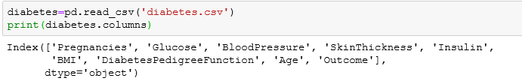
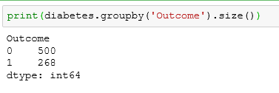
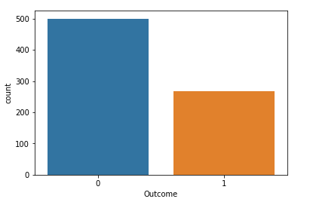

Analysis of Dataset :
Columns index
Outcome ‘0’ or ‘1’
Dimension of dataset
Outcome using matplotlib

Slide 9
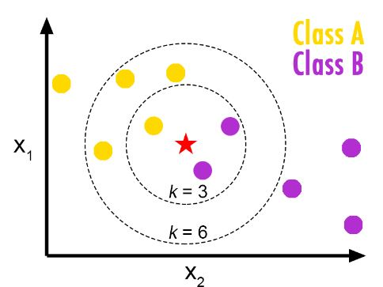
K-Nearest Neighbors (KNN) Algorithm:
The k-NN algorithm a simplest machine learning algorithm.
Building the model consists only of storing the training dataset.
To make a prediction for a new data point, the algorithm finds the closest data points in the training dataset — its “nearest neighbors.
It classifies a data point based on how its neighbors are classified
KNN makes predictions just-in-time by calculating the similarity between an input sample and each training instance.

Slide 10
METHODOLOGY:
Open Jupyter Notebook
Imports Libraries & Modules
Import Dataset
Apply K-NN Algorithm
Training Data
Input New Data
Predicts Output

Slide 11
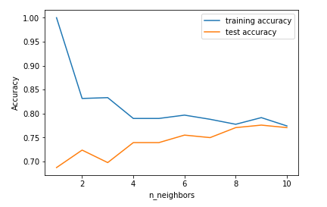
Visualization of training and test data accuracy
Of K-NN:
Accuracy of K-NN classifier on training set: 0.79
Accuracy of K-NN classifier on test set: 0.78
Fig: The plot shows the training and test set accuracy on the y-axis against the setting of neighbors on the x-axis.

Slide 12

Take user input:
have uses voice system that tells to give input

Slide 13

Output and Prediction:
Analysis the user input the system will predict diabetes ‘yes’ or ’not,
Output for yes
Output for no

Slide 14
Training and test data accuracy Of DECISION TREE:
The accuracy on the training set is 100%, while the test set accuracy is much worse. This is an indicative that the tree is overfitting and not generalizing well to new data.
We set max_depth=3, limiting the depth of the tree decreases overfitting. This leads to a lower accuracy on the training set, but an improvement on the test set.
Accuracy on training set: 1.000
Accuracy on test set: 0.714
Accuracy on training set: 0.773
Accuracy on test set: 0.740

Slide 15
Conclusion and Future Work:
In this paper we analyze the diabetes data and predicts about diabetes.
We predict the outcome based on KNN algorithm
In future we want to do this prediction with lots of data
We also want to apply others machine learning algorithms
We also want to implement in our country’s health sector.

Slide 16
Any Question?

Slide 17

THANK YOU!

